Slide 1
Driving Towards a Safer Future Part 3: Model Construction
Mikhail Hershfeld – Spring 2020

Slide 2
Recap
Data being used is 3 million accident records in the US from 2016-2019.
Goal is to predict accident severity in terms of traffic delays based only on immediately known variables.
Decided to go with a random forest algorithm due to their versatility and my familiarity with them.
West Virginia and Arkansas were found to have a disproportionally high amount of severe accidents

Slide 3
Outliers
West Virginia and Arkansas both had abnormally high rates of very severe accidents.
Fairly difficult to determine why, especially for WV.
What was found:
WV and AR are 4th and 5th respectively in number of drivers in fatal collisions per billion miles.
AR highways have high traffic volume and especially high freight volume.
Numerous qualitative sources indicating AR highways are narrow.
AR has large swaths of national forests surrounding highways.

Slide 4
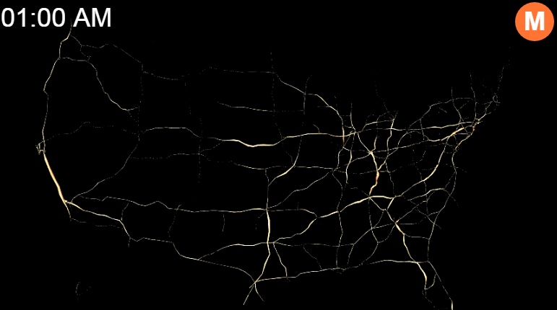
Daily U.S. Traffic Volume
Source: Max Galka, Metrocosm, 2016

Slide 5
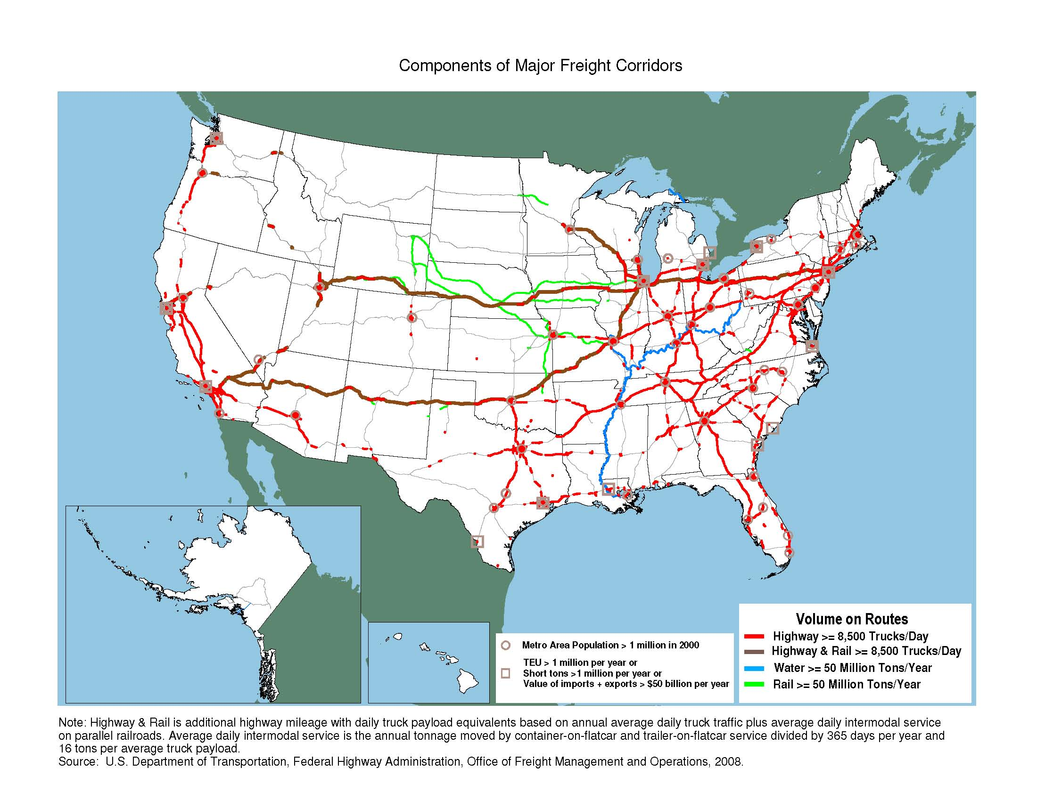

Slide 6
Outliers
Rt 30 in AR got average daily traffic volume of 3,859,140 cars (2017).
Rt 40 in AR got 3,698,290 daily cars (2017).
“Work on a $187.3 million project to widen a section of Interstate 30 in Saline County…The work is part of a project to widen 5.5 miles of Interstate 30 to six lanes from four…” (Arkansas Democrat-Gazette, 2019).
“Is there a stretch of interstate that always gets on your nerves? - To start off, mine is I-40 between Little Rock and Memphis. Two lanes + endless semis = unneeded traffic. Arkansas needs to get off their butts and extend it to at least 3 lanes.” (Reddit, 2018).

Slide 7
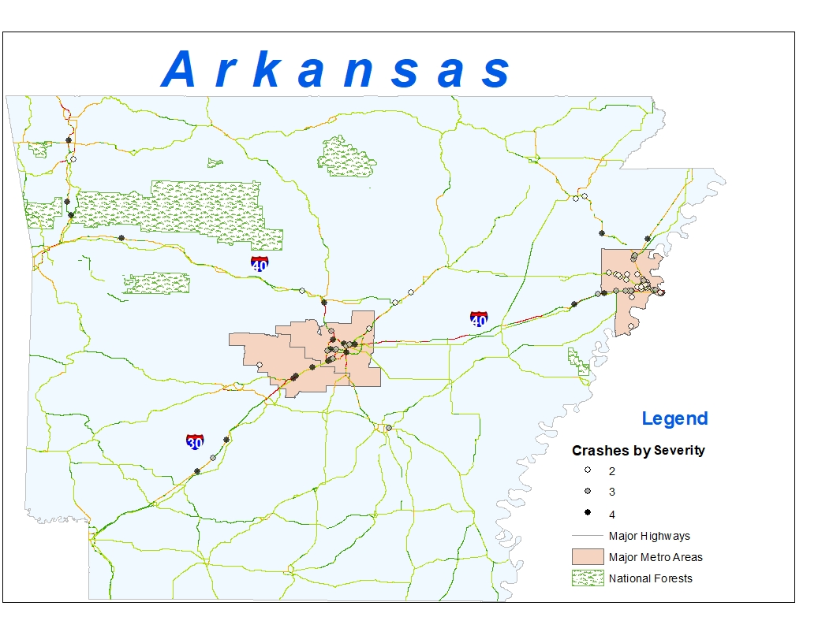

Slide 8
Outliers
Combination of high traffic volume + large amount of trucks + narrow roads + national forests may be cause of high number of severe accidents in AR.
WV is unexplained. No such factors.
Lack of hard data on road widths and general qualitative sources make this hypothesis difficult to prove.

Slide 9
The Main Event

Slide 10
Feature Engineering
Dropped features with very little relationship to severity. From correlogram and chi-sq testing.
Encoded type of road – Interstate Hwy, State Hwy, Numbered Hwy, and County Hwy.
Added several fields based on information gleaned from description
Multi-Vehicle collision
Relatively serious collision
Oil/Fuel Spillage
In a construction zone
Road immediately blocked
Jacknifed trailer
Ramp immediately blocked

Slide 11
Baseline Model Testing
Data is extremely imbalanced, and no exact definition of “Severity”
.05% of crashes are a 1
66.5% of crashes are a 2
33.1% of crashes are a 3
.35% of crashes are a 4
Could lump 1-> 2 and 4 -> 3 and turn into binary classification.
Decided to leave as a multi-classification problem

Slide 12
Baseline Model Testing
First run – Random Forest model with more balanced classes and untuned hyperparameters.
Train Data Confusion Matrix. Row Labels - Actual Class, Column Labels - Predicted Class.
 | 1 | 2 | 3 | 4 | Error | Rate
1 | 0 | 23,521 | 559 | 0 | 1 | 24,080/24,080
2 | 0 | 115,400 | 6,122 | 0 | 0.0503 | 6,122 / 121,522
3 | 0 | 6,982 | 73,918 | 0 | 0.0863 | 6,982 / 80,900
4 | 0 | 6,828 | 81,852 | 0 | 1 | 88,680 / 88,680
Total | 0 | 152,731 | 162,451 | 0 | 0.3993 | 125,864 / 315, 182
Validation Data Confusion Matrix. Row Labels - Actual Class, Column Labels - Predicted Class.
 | 1 | 2 | 3 | 4 | Error | Rate
1 | 0 | 106 | 2 | 0 | 1 | 108 / 108
2 | 0 | 128,329 | 6,766 | 0 | 0.05 | 6766 / 135,095
3 | 0 | 5,626 | 61,770 | 0 | 0.0834 | 5,626 / 67, 396
4 | 0 | 46 | 648 | 0 | 1 | 694 / 694
Total | 0 | 134,107 | 69,186 | 0 | 0.0649 | 13,194 / 203,293

Slide 13
Baseline Model Testing
Initial model completely ignores minority classes, 100% error rate. 93.5% overall accuracy rate highly misleading.
Instead of balancing classes via duplicate sampling, tried generating synthetic instances of the minority classes.
Synthetic Minority Oversampling Technique (SMOTE) finds KNN of minority class instances, chooses 1 neighbor at random, and generates new data points.
Uses convex combination of attributes.

Slide 14
Model Testing With SMOTE
More promising results, 53.3% accuracy of severe accidents rather than 0%.
Trade off for greater variance, and level 1’s being ignored.
Train Data Confusion Matrix. Row Labels - Actual Class, Column Labels - Predicted Class.
 | 1 | 2 | 3 | 4 | Error | Rate
1 | 220,600 | 27,142 | 772 | 1,486 | 0.1176 | 29,400 / 250,000
2 | 9,041 | 388,274 | 16,888 | 5,797 | 0.0755 | 31,726 / 420,000
3 | 1,197 | 17,442 | 281,900 | 99,461 | 0.2952 | 118,100 / 400,000
4 | 548 | 822 | 39,416 | 359,214 | 0.1019 | 40,786 / 400,000
Total | 231,386 | 433,680 | 338,976 | 465,958 | 0.1496 | 220,012 / 1,470,000
Validation Data Confusion Matrix. Row Labels - Actual Class, Column Labels - Predicted Class.
 | 1 | 2 | 3 | 4 | Error | Rate
1 | 9 | 186 | 5 | 0 | 0.9555 | 191 / 200
2 | 1,729 | 253,704 | 10,817 | 3,760 | 0.0603 | 16,306 / 270,010
3 | 76 | 10,763 | 99,766 | 24,351 | 0.2607 | 35,190 / 134,956
4 | 0 | 91 | 574 | 759 | 0.4669 | 665 / 1,424
Total | 1,814 | 264,744 | 111,162 | 28,870 | 0.1287 | 52,352 / 406,590

Slide 15
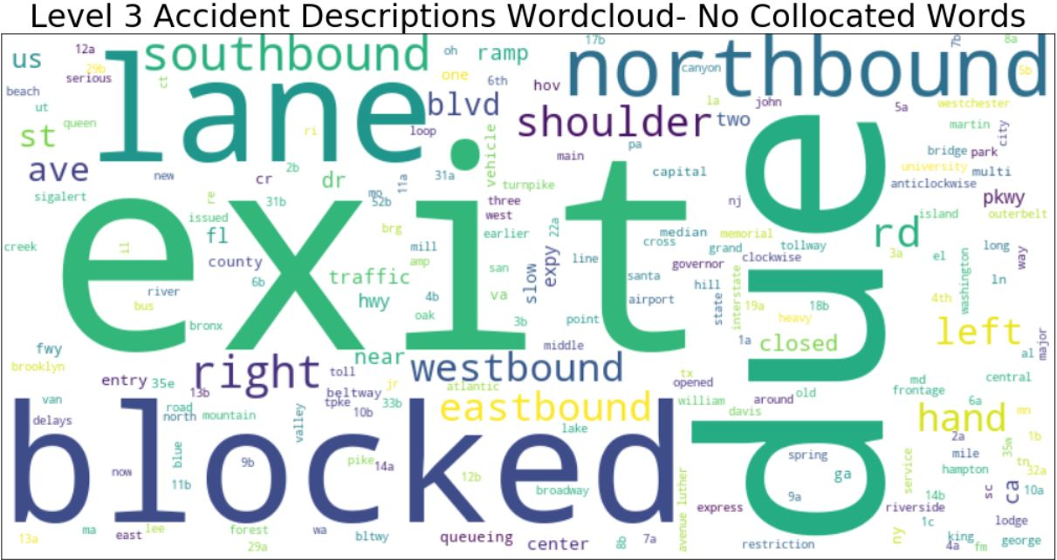
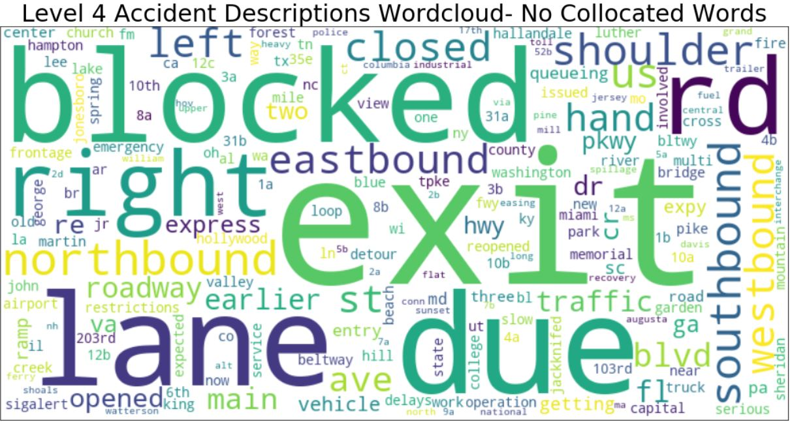
Steps for Improvement
Greater differentiation of level 4 from 3 is next step before model tuning.
Level 4 appears to have a more even distribution of most common words.

Slide 16
Steps for Improvement
Noteworthy finds in how many times a word appeared in Level 4 descriptions vs in Level 3:
“near”: .17
“ramp”: .37
“slow”: .37
“center”: .50
“main”: 8.21
“st”: 4.15
“closed”: 2.72
“lanes”: 3.37
Noteworthy words that appeared only in Level 4 descriptions:
“emergency”
“vehicles”
“earlier”
“roadway”
“re-opened”
“delays”
“detour”
“operation”

Slide 17
Steps for Improvement
PLEASE give me feedback, there are many different routes I could have and can take with this project. I would highly value solid, constructive input… and I’ve suddenly found myself with a great deal more free time.
Thank you for watching!

Slide 18
References and Data Sources
Arkansas Road Inventory (2017). Arkansas GIS Office. Retrieved from https://gis.arkansas.gov/product/arkansas-road-inventory/
Galka, M. (2016, September 26). Watch 24 Hours of Traffic, Visualized as a Living Circulatory System. Metrocosm. Retrieved from http://metrocosm.com/map-us-traffic/
I-30 work to close lanes for two weeks. (2019, September 7). Arkansas Democrat-Gazette. Retrieved from https://www.arkansasonline.com/news/2019/sep/07/i-30-work-to-close-lanes-for-two-weeks-/?news-arkansas
Is there a stretch of interstate that always gets on your nerves? (2018). Reddit. Retrieved from https://www.reddit.com/r/AskAnAmerican/comments/6m8jv0/is_there_a_stretch_of_interstate_that_always_gets/
Components of Major Freight Corridors Map. (2008). US Department of Transportation, Federal Highway Administration, Office of Freight Management and Operations. Retrieved from https://ops.fhwa.dot.gov/freight/freight_analysis/nat_freight_stats/compofmajorfghtcorr.htm

